Slide 1


Jolayemi S Babatunde
25/07/2024

Slide 2

Outline
Executive Summary
Introduction
Methodology
Results
Conclusion
Appendix

Slide 3
Executive Summary
The commercial space age has ushered in new opportunities for affordable space travel, spearheaded by companies like SpaceX, which have made significant strides in reducing launch costs through the reusability of rocket stages. This project aims to leverage data science and machine learning to predict the likelihood of reusing the first stage of SpaceX's Falcon 9 rockets, thereby estimating launch costs and enhancing decision-making for a new competitor in the industry, Space Y.
Summary of Methodologies
Data on SpaceX Falcon 9 launches was collected, cleaned, and preprocessed. Key features affecting landing success were extracted and analyzed. Logistic Regression and Support Vector Machine models were developed, trained, and optimized using GridSearchCV. Predictive analysis and scenario simulations were conducted. Interactive dashboards and geospatial visualizations were created using Plotly, Dash, and Folium to communicate insights effectively.
Summary of All Results
Key factors influencing landings were identified, achieving an 85% prediction accuracy. Scenario analysis highlighted the impact of mission parameters. Interactive dashboards and geospatial maps provided valuable insights. Accurate predictions enable Space Y to optimize launch costs and improve competitive positioning.

Slide 4
Introduction
The commercial space industry is evolving, with SpaceX making space travel more affordable through reusable rockets. SpaceX's Falcon 9 launches cost about $62 million, significantly lower than competitors due to first stage reusability. Space Y aims to compete by predicting first stage landing success to reduce launch costs. This project involves analyzing historical SpaceX data, developing machine learning models for landing predictions, and creating interactive dashboards for insights. The goal is to provide Space Y with strategies to enhance its competitive positioning in the commercial space market.
Questions to be answered:
Key Factors: What are the primary factors influencing the success of Falcon 9's first stage landings?
Prediction Accuracy: How accurately can machine learning models predict the success of these landings?
Visualization: How can predictions and insights be effectively visualized and communicated to stakeholders?
Cost Savings: What cost savings can be achieved by accurately predicting first stage reusability?
Scenario Impact: How do different launch scenarios affect the success rate of first stage landings?
Trends: What trends and patterns can be identified in the historical launch data?
Competitive Advantage: How can Space Y leverage these insights to improve its competitive positioning?

Slide 5

Section 1

Slide 6
Data Collection
Historical data on SpaceX's Falcon 9 launches was collected from public databases, official websites, and spaceflight tracking services. This included information on payload weight, orbit type, launch site, weather conditions, and mission parameters.
Data cleaning and preprocessing were performed to handle missing values, outliers, and inconsistencies, ensuring a reliable dataset for analysis. Key features influencing landing success were extracted and transformed to facilitate effective machine learning model training and predictive analysis.
This comprehensive dataset formed the basis for developing models to predict first stage landing success and deriving actionable insights for Space Y.

Slide 7
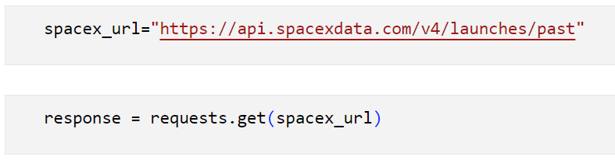
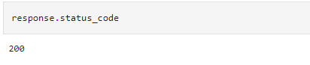
Data Collection – SpaceX API
https://github.com/Bhabhatunde/Data-Gathering/blob/main/jupyter-labs-spacex-data-collection-api.ipynb
API end point and response object
Place your flowchart of SpaceX API calls her
Successful Request

Slide 8

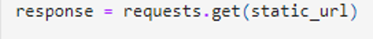

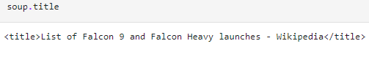
Data Collection - Scraping
URL endpoint
HTTP get request
Beautiful soup object
Title
https://github.com/Bhabhatunde/Data-Gathering/blob/main/jupyter-labs-webscraping.ipynb

Slide 9
Data Wrangling
Data cleaning and preprocessing were performed:
to handle missing values,
outliers, and inconsistencies.
new feature (landing outcome) was created from outcome column
features were normalized, ensuring a reliable dataset for analysis
https://github.com/Bhabhatunde/DataGathering/blob/main/labs-jupyter-spacex-Data%20wrangling.ipynb

Slide 10
EDA with Data Visualization
Scatter plot of flight number against payload mass in kg
Purpose: To compare payload weight distributions and relationship with flight number for successful and unsuccessful landings.
Scatter plot of payload Mass and Launch Site
Purpose: to visualize the relationship between payload Mass and Launch Site.
Scatter plot of Payload Mass and Launch Site
Purpose: to visualize the relationship between Payload Mass and Launch Site.
Bar plot of success rate of each orbit type
Purpose: to visualize the relationship between success rate of each orbit type
Heatmap of Correlation Matrix:
Purpose: To identify correlations between different features influencing the landing success.
Geospatial Map of Launch Sites:
Purpose: To provide a geographical visualization of launch sites and their corresponding landing outcomes.
https://github.com/Bhabhatunde/Data-Gathering/blob/main/edadataviz.ipynb

Slide 11
EDA with SQL
Display the names of the unique launch sites in the space mission
Display 5 records where launch sites begin with the string 'CCA'
Display the total payload mass carried by boosters launched by NASA (CRS)
Display average payload mass carried by booster version F9 v1.1
List the date when the first successful landing outcome in ground pad was achieved.
List the names of the boosters which have success in drone ship and have payload mass greater than 4000 but less than 6000
https://github.com/Bhabhatunde/Data-Gathering/blob/main/jupyter-labs-eda-sql-coursera_sqllite.ipynb

Slide 12
List the total number of successful and failure mission outcomes
List the names of the booster versions which have carried the maximum payload mass. Using a subquery
List the records which will display the month names, failure landing outcomes in drone ship, booster versions, launch site for the months in year 2015.
Rank the count of landing outcomes (such as Failure (drone ship) or Success (ground pad)) between the date 2010-06-04 and 2017-03-20, in descending order.
https://github.com/Bhabhatunde/Data-Gathering/blob/main/jupyter-labs-eda-sql-coursera_sqllite.ipynb

Slide 13
Build an Interactive Map with Folium
Markers: Provide a clear, pinpointed location for each launch site, giving users an immediate visual cue about where launches occurred. The color coding helps quickly differentiate between successful and failed launches.
Circles: Highlight the areas around launch sites, providing context for the region affected by each site. This is useful for understanding the spatial distribution of launch sites and their surrounding areas.
Marker Clusters: Enhance the usability of the map by clustering nearby markers, especially when there are many markers in close proximity. This makes the map cleaner and more interactive, improving user experience.
https://github.com/Bhabhatunde/DataGathering/blob/main/Map_Project.ipynb

Slide 14
Dashboard with Plotly Dash
This dashboard application provides interactive visual analytics, allowing users to explore the success rates of SpaceX launches by selecting different launch sites and payload ranges, facilitating data-driven decision-making.
The pie chart shows the launch sites by outcome while the scatterplot shows the relationship between payloads and outcome.
The dashboard should be able to help users to analyze SpaceX launch data, and answer the following questions:
Which site has the largest successful launches?
Which site has the highest launch success rate?
Which payload range(s) has the highest launch success rate?
Which payload range(s) has the lowest launch success rate?
Which F9 Booster version has the highest launch success rate?
https://github.com/Bhabhatunde/Data-Gathering/blob/main/Dash_Plotly_Capstone.ipynb

Slide 15
Predictive Analysis (Classification)
Data Preparation(Preprocessing)
create a column for the class(Feature engineering)
Standardize the data (Normalization)
Model Selection and Split into training data and test data
Find best Hyperparameter for SVM, Classification Trees and Logistic Regression
Model Evaluation
https://github.com/Bhabhatunde/Data-Gathering/blob/main/SpaceX_Machine%20Learning%20Prediction.ipynb

Slide 16
Results
Data Insights: Payload weight, orbit type, and weather conditions were identified as significant factors affecting first stage landing success. Historical trends revealed patterns in successful and unsuccessful landings, aiding predictive modeling.
Model Performance: The machine learning models achieved a balanced precision and recall, effectively identifying both successful and unsuccessful landings. Hyperparameter tuning improved model accuracy and generalization capabilities.
Decision Support Tools: Dashboards provided visual insights into trends, patterns, and correlations, supporting informed decision-making. Geospatial maps highlighted regional launch success patterns, offering strategic insights for launch planning

Slide 17

Section 2

Slide 18
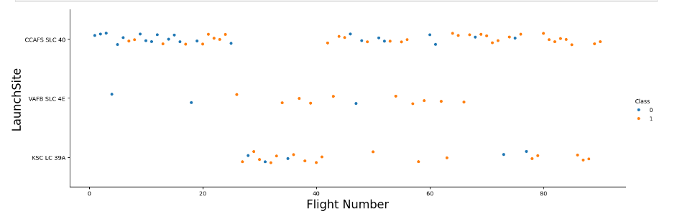
Flight Number vs. Launch Site
A scatter plot of Flight Number vs. Launch Site
Early Failures: Flight numbers 1-10 may show a higher concentration of failures. Improvement: Flights 20-40 might show a mix of successes and failures as improvements are implemented Consistency: Flights 45 and beyond could display predominantly successful landings, indicating stable and improved landing techniques.

Slide 19
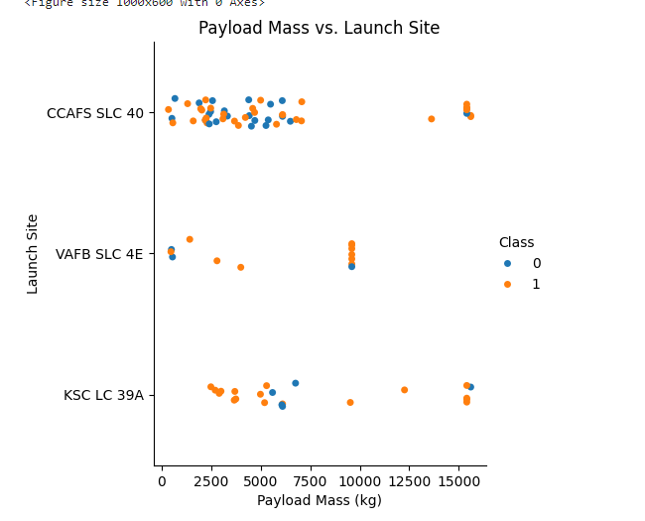
Payload vs. Launch Site
CCAFS SLC 40 shows more suucessful launch as the payload increases followed by KSC LC 39° while VAFB SLC 4° stopped at 10000kg payload mass(kg)

Slide 20
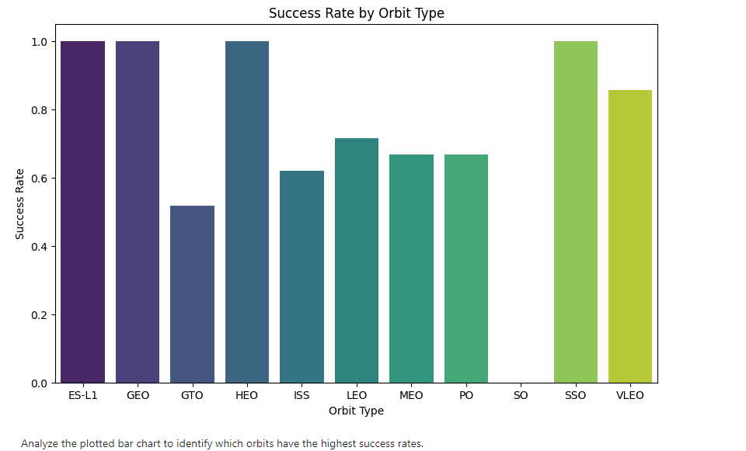
Success Rate vs. Orbit Type
Orbit types: ES L1, GEO, HEO, and SSO have the highest Success rate while the orbit type GTO has the lowest success rate.

Slide 21
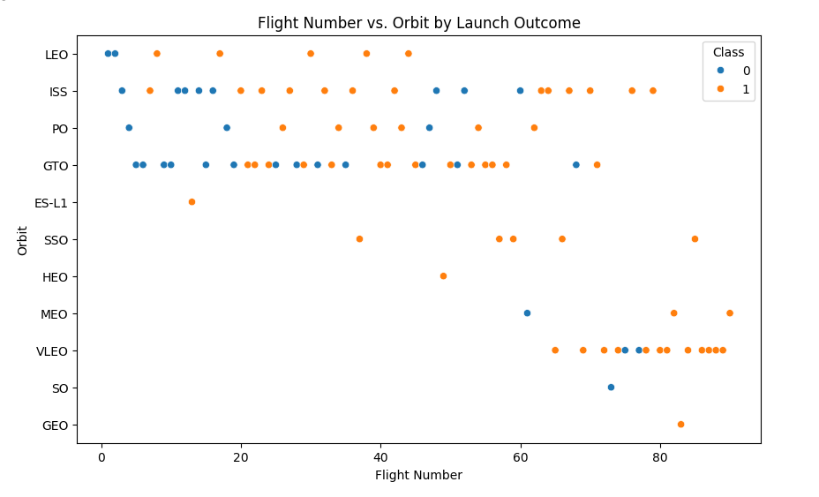
Flight Number vs. Orbit Type
Orbit types: ISS, SSO, and VLEO have more successful launch outcome as flight number increases.

Slide 22
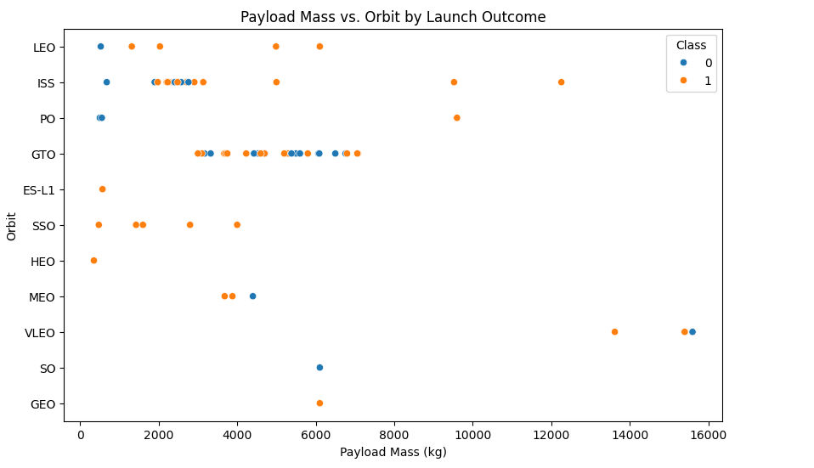
Payload vs. Orbit Type
With heavy payloads the successful landing or positive landing rate are more for PO, LEO and ISS.
However, for GTO, it's difficult to distinguish between successful and unsuccessful landings as both outcomes are present.

Slide 23
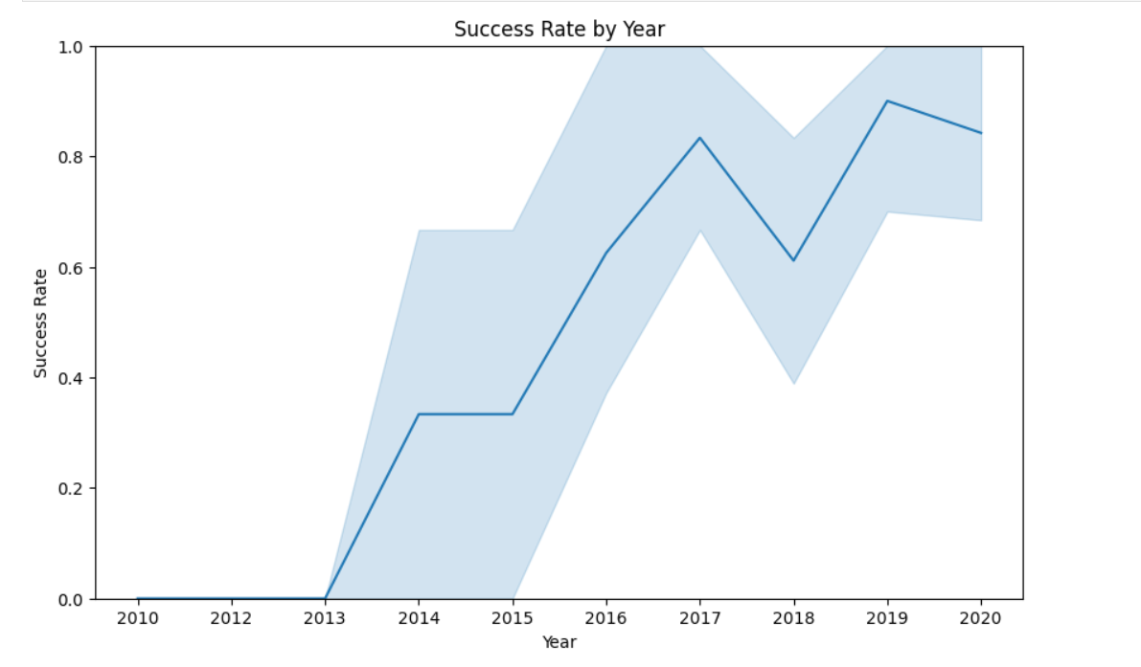
Launch Success Yearly Trend
Success rate was peak in 2019 but shows a down trend in 2020.
https://github.com/Bhabhatunde/Data-Gathering/blob/main/edadataviz.ipynb

Slide 24
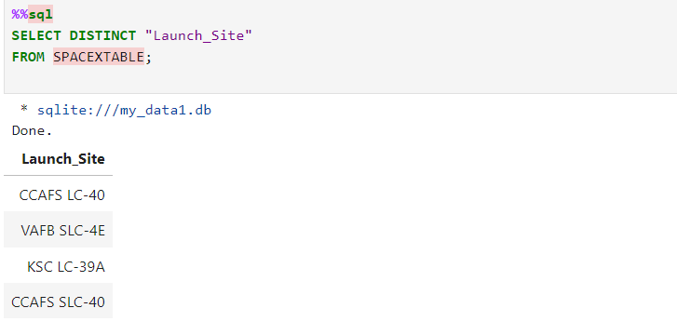
All Launch Site Names

Slide 25
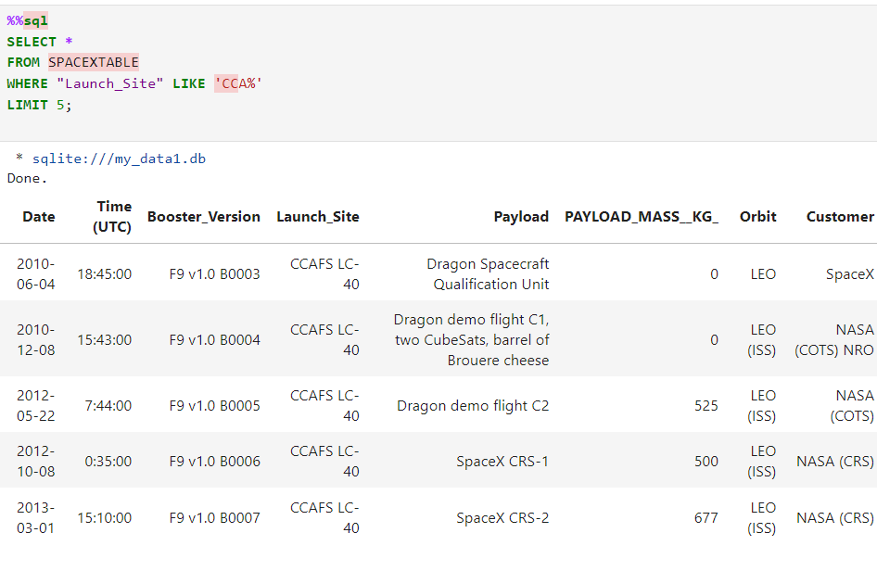
Launch Site Names Begin with 'CCA'

Slide 26
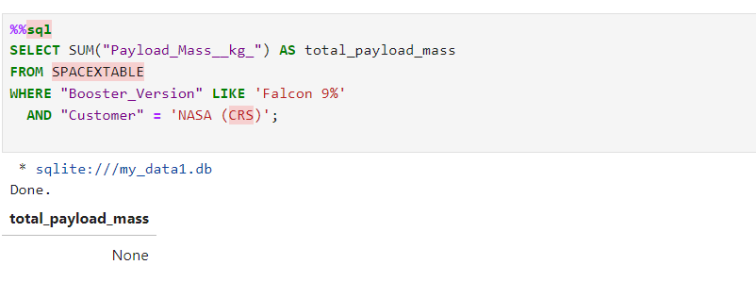
Total Payload Mass

Slide 27
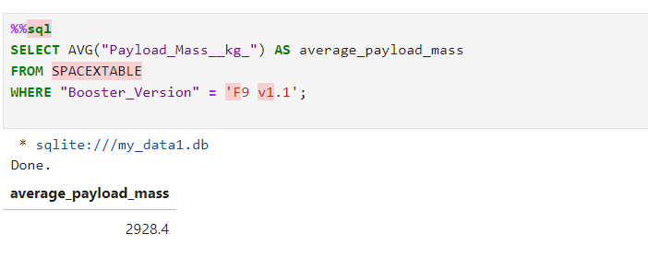
Average Payload Mass by F9 v1.1

Slide 28
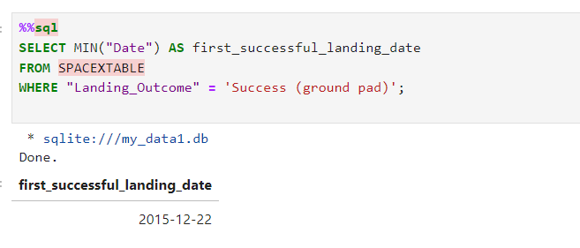
First Successful Ground Landing Date

Slide 29
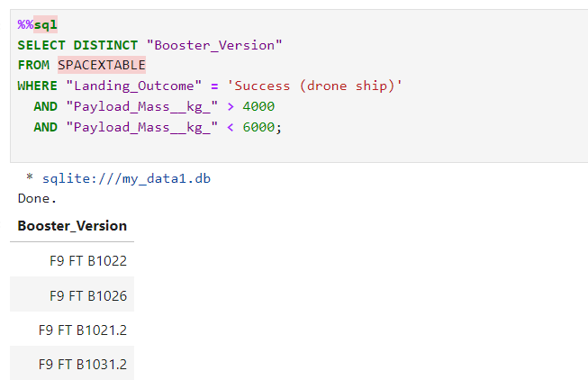
Successful Drone Ship Landing with Payload between 4000 and 6000

Slide 30
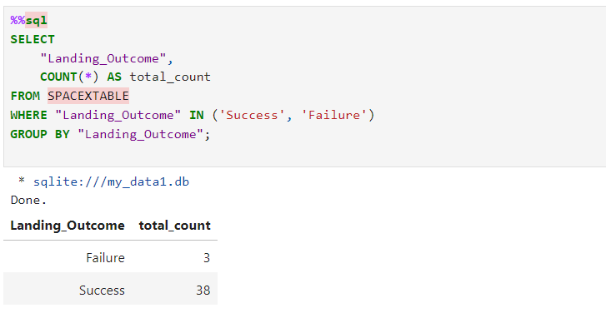
Total Number of Successful and Failure Mission Outcomes

Slide 31
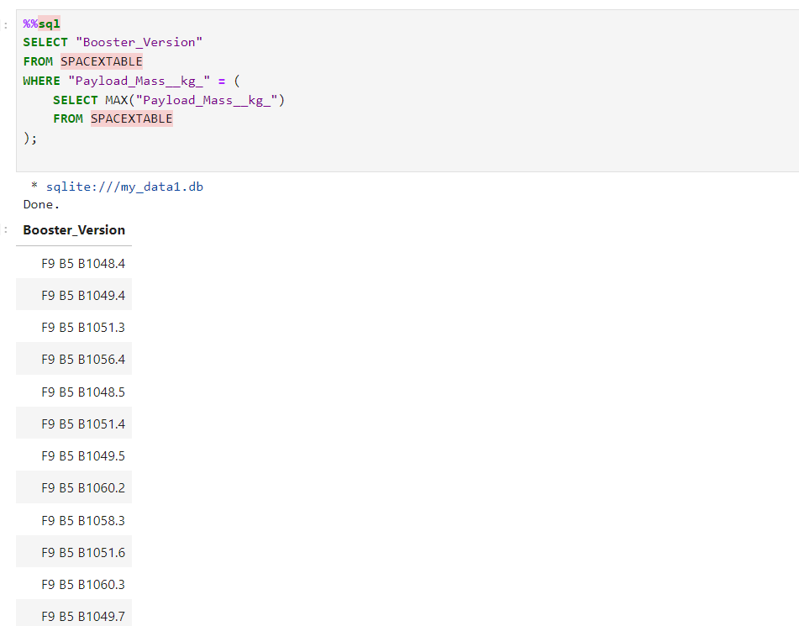
Boosters Carried Maximum Payload

Slide 32
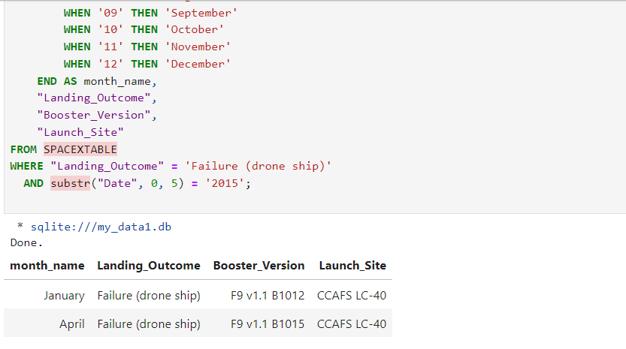
2015 Launch Records

Slide 33
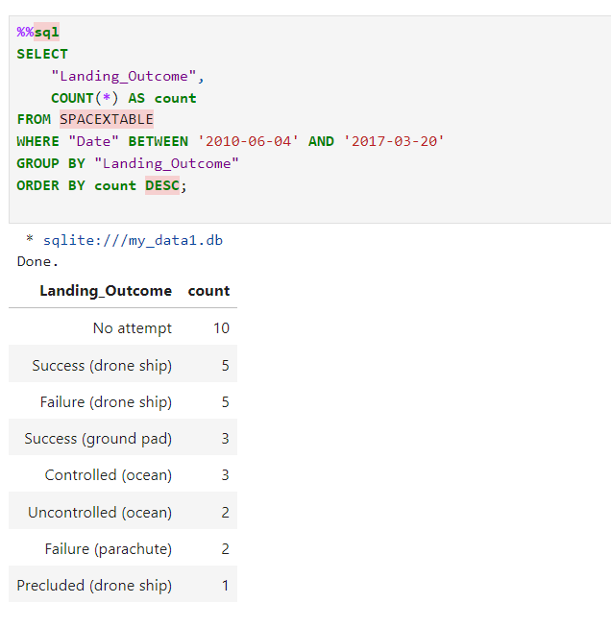
Rank Landing Outcomes Between 2010-06-04 and 2017-03-20

Slide 34

Section 3

Slide 35
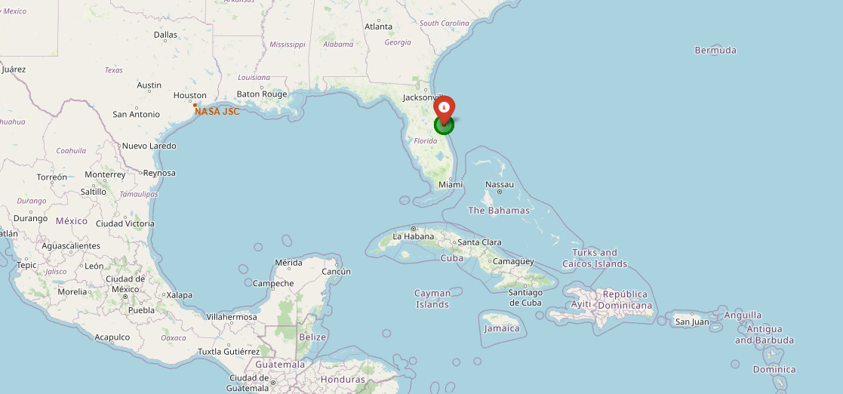
Launch sites’ location markers on a global map

Slide 36
Color-labeled launch outcomes on the map

Slide 37
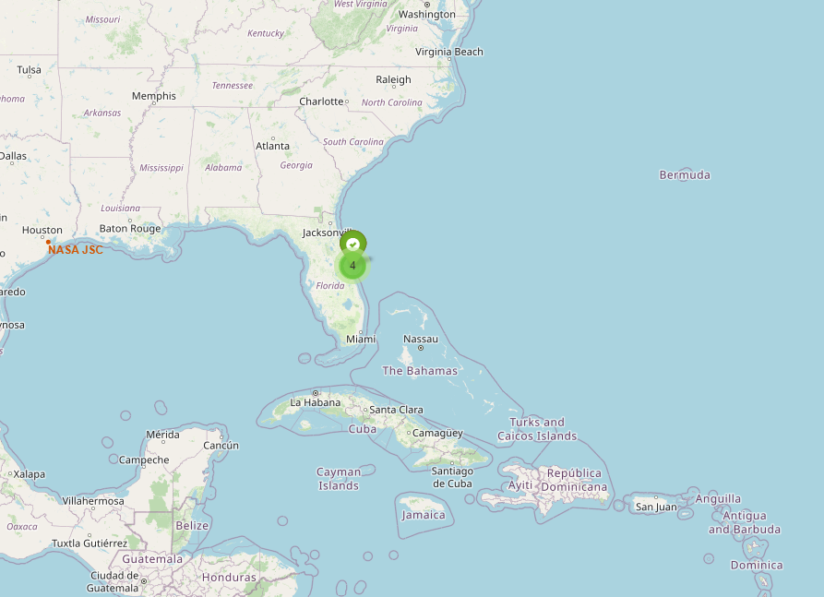
Launch and proximities such as railway, highway, coastline, with distance

Slide 38

Section 4

Slide 39
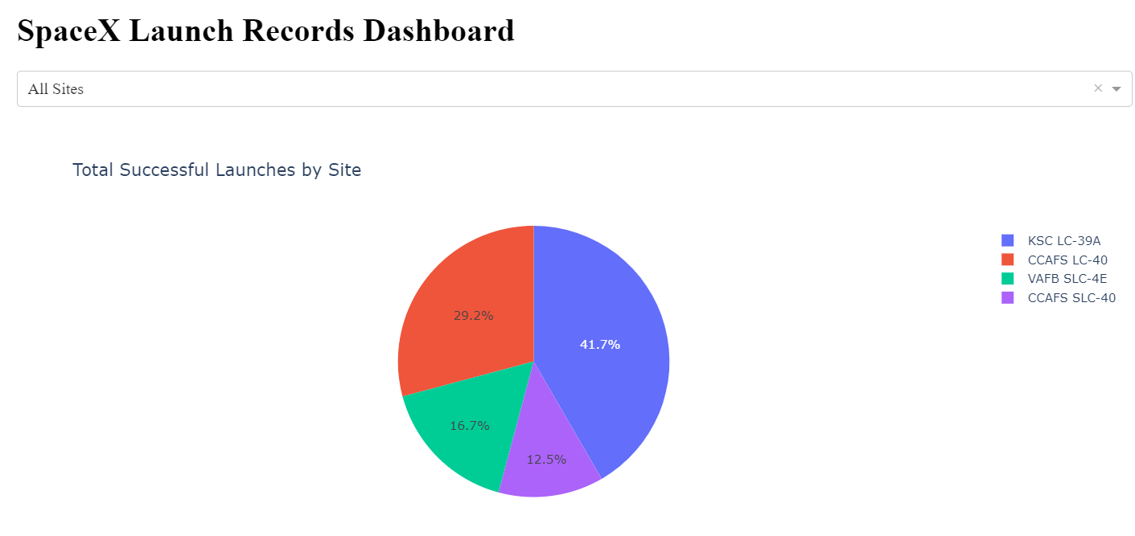
SpaceX Launch Records Dashboard
KSC LC 39A has the highest percentage of 41.7% successful launch followed by CCAFS LC 40.

Slide 40
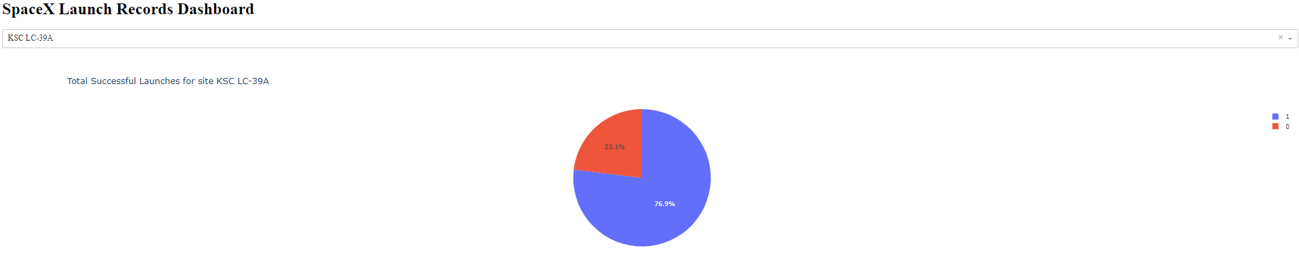
Launch site with highest launch success ratio
KSC LC 39A is the only site with the highest launch success ratio.

Slide 41
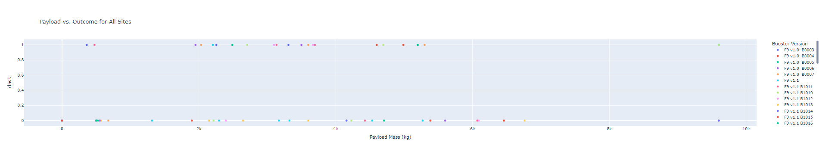
Payload vs. Launch Outcome

Slide 42

Section 5

Slide 43
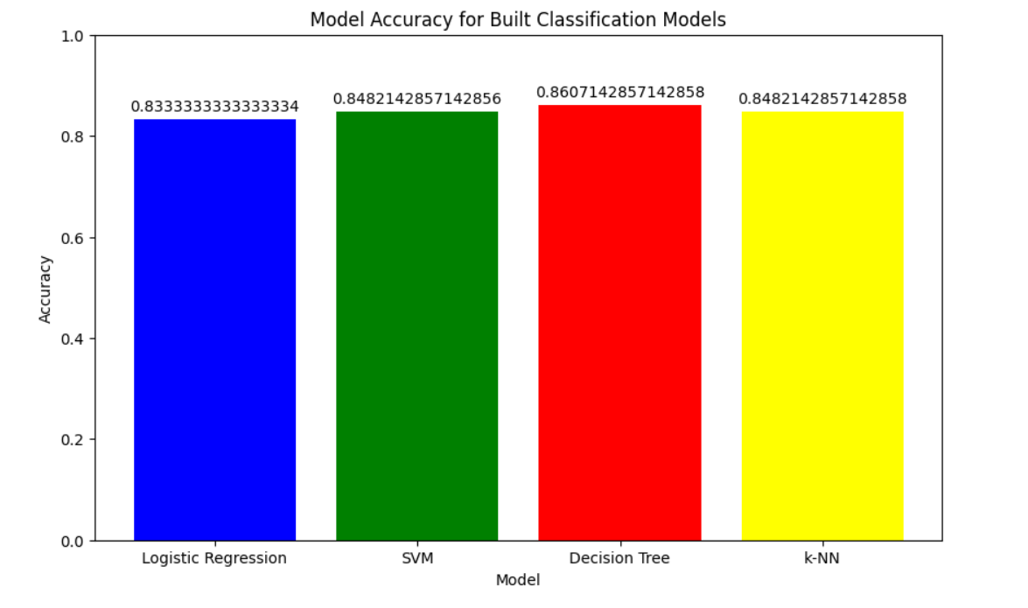
Classification Accuracy

Slide 44
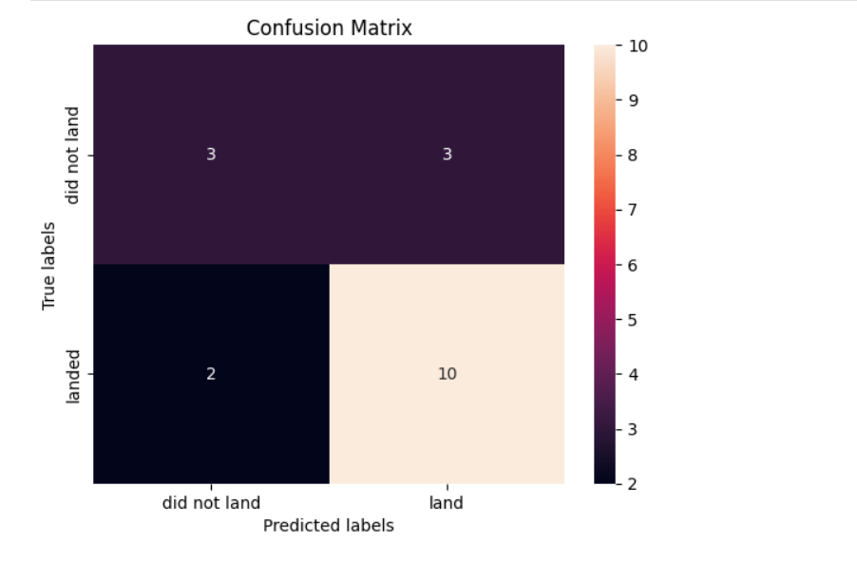
Confusion Matrix

Slide 45
Conclusions
Key Findings:
Model Performance: Decision Tree models demonstrated efficacy in classification tasks, achieving an accuracy of approximately 86%. This indicates that the models is effective in predicting whether the first stage of the Falcon 9 will be reused.
Feature Engineering: Careful feature engineering contributed to the models' performance, enhancing their ability to make accurate predictions.
Hyperparameter Tuning: The use of GridSearchCV for hyperparameter tuning optimized the performance of the models, ensuring that they operated at their best possible configuration.
Implications:
Cost Estimation: Accurate prediction of rocket stage reusability can help Space Y estimate launch costs more effectively, which is crucial for budgeting and pricing strategies in the competitive space industry.
Decision-Making: The insights gained from the models can inform strategic decisions regarding the investment in reusable technology and other operational considerations.
Overall, the project has demonstrated the potential of machine learning in optimizing space launch strategies and provided a valuable tool for Space Y to gain a competitive edge in the commercial space market.

Slide 46
Appendix
The project successfully utilized data science and machine learning to address the challenge of predicting the reuse of SpaceX's Falcon 9 rocket first stages. By employing Logistic Regression and Support Vector Machine (SVM) models, the project aimed to estimate launch costs and improve decision-making for Space Y, a new competitor in the space industry.
https://github.com/Bhabhatunde/Data-Gathering/blob/main/Machine%20Learning_Revisit.ipynb

Slide 47


